Slide 1
Unit 9: Economics
World Economy & Trade

Slide 2
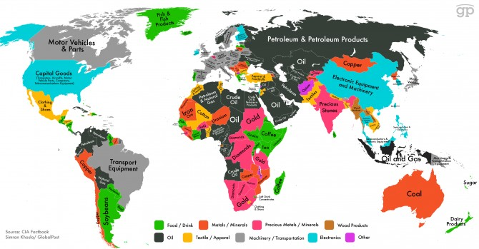
Why Nations Trade
Need goods/services they don’t have
Countries specialize in certain goods/services
Resources avail in a country can determine what it makes

Slide 3
Trade and Comparative Advantage
Absolute advantage: when a country can produce more of a given product than another country can
Comparative advantage: when a country can provide a product more efficiently (at a lower opportunity cost) than another country can
Countries use a variety of trade barriers - limits on the exchange of goods

Slide 4
Tariffs
Tariff = tax on imports.
Revenue tariffs = tax used to raise money for a government
Protective tariff makes foreign goods cost more and reduces demand
Why is this a good thing????

Slide 5
Import Quotas and Voluntary Restrictions
Import quota - law that limits the amt of a particular imported good
Voluntary trade restriction - agreement between two countries to limit certain trade.
Some countries require a special license
Help domestic business…why???

Slide 6
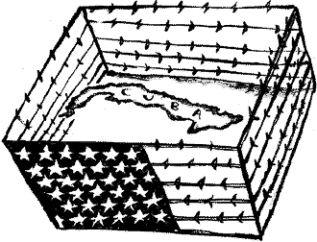
Embargoes
Embargo - bans trade with specific countries
Usually for political rather than economic reasons
U.S. w/Cuba due to its opposition of former president Fidel Castro (ended this year)

Slide 7
International Cooperation
Reciprocal trade agreements – usually reduce protective tariffs
Ex: U.S. Congress can grant Normal Trade Relations (NTR) status to other countries, which may give them lower tariff rates

Slide 8
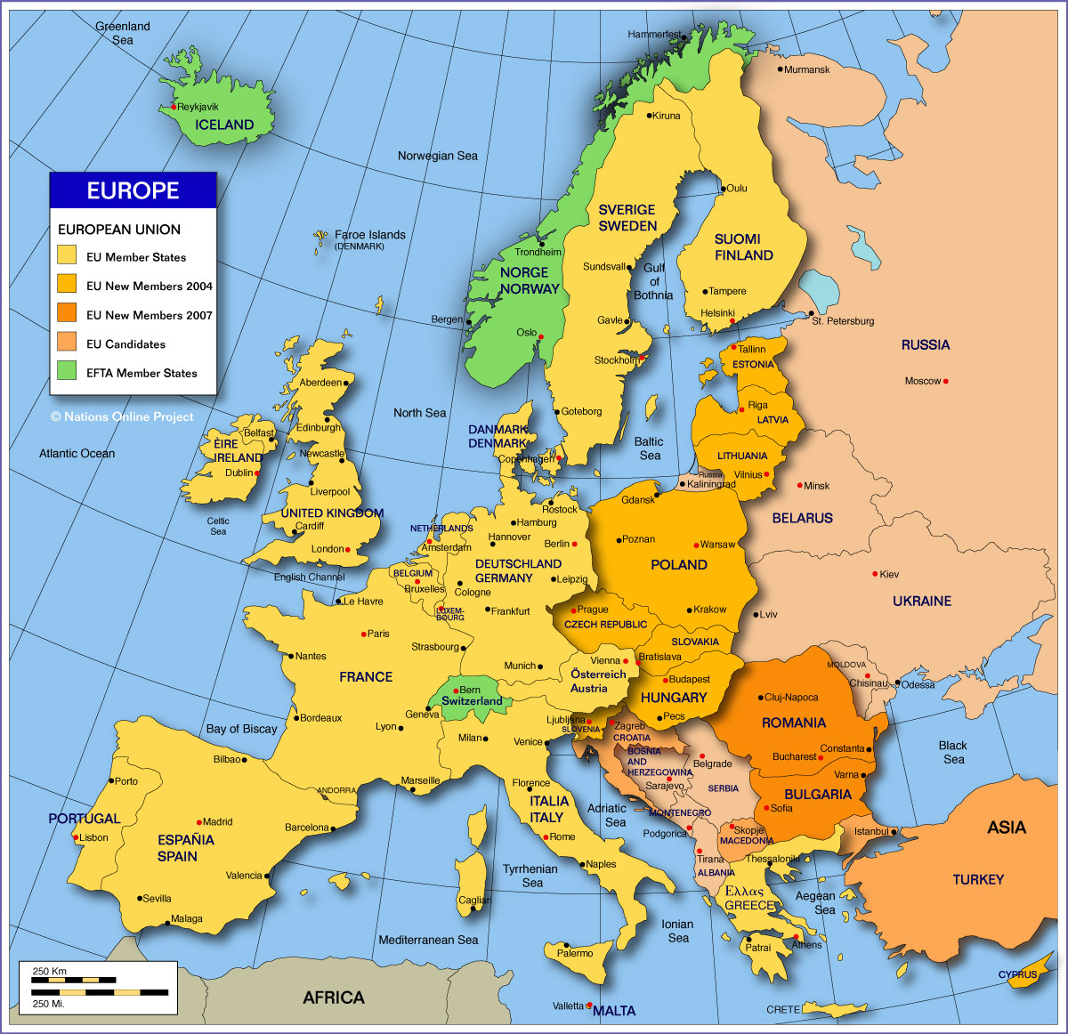
Regional Trade Agreements
Many neighboring countries have regional trade organizations
reduce or eliminate trade barriers among members
Ex: The European Union (EU)

Slide 9
International Trade Agreements
Countries have international trade agreements to reduce trade barriers
Ex: The World Trade Organization (WTO), 1995 / by 2005, 149 countries belonged.
Ex: The North American Free Trade Agreement (NAFTA) 1994, between The United States, Mexico, and Canada
goal is to gradually remove all trade barriers

Slide 10
Protectionism
Protectionism: when countries limit the exchange of goods across their borders
Reasons some support:
Protects industries/jobs
Maintains high wages
National Security
Reasons to oppose:
May lead to price increases
Trade wars

Slide 11
Free Trade
Free trade - countries work with each other to trade w/few restrictions or stipulations
Benefits:
Create jobs bc a higher demand of a countries goods
Allows access to scarce goods in a country
More choices/options in goods
International Relations
Increase competition (lower prices)

Slide 12
International Trade
Balance of payments - difference btwn value of a country’s exports & its imports
Trade surplus: country sells more than it buys
Trade deficit: country buys more than it sells
2005 - the U.S. imported $1.99 trillion and exported $1.27 trillion

