Slide 1
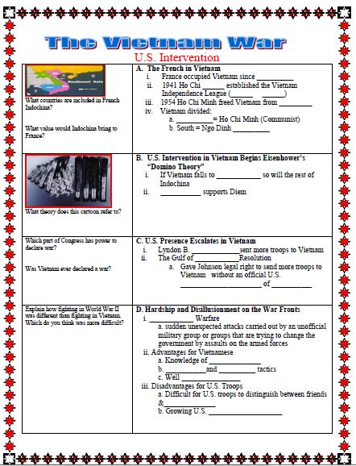
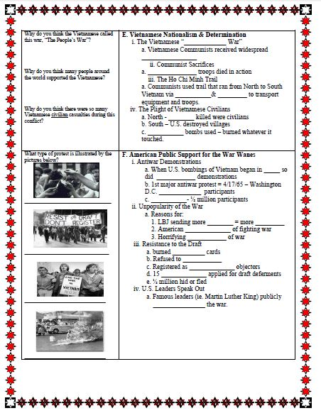
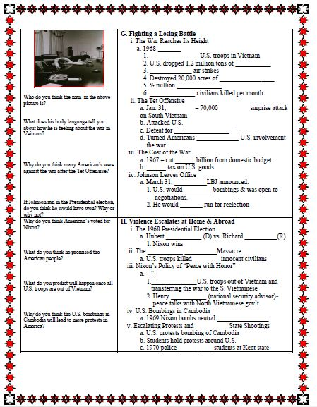
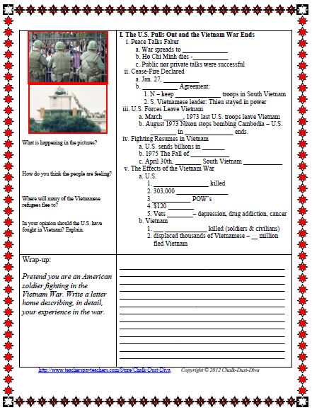
The Vietnam War
U.S. Intervention
Lecture & Activity
Notes:
http://www.teacherspayteachers.com/Store/Chalk-Dust-Diva Copyright © 2012 Chalk-Dust-Diva

Slide 2
Pair-Share
What do you already KNOW about the Vietnam War?
What do you WANT to learn more about?
What do you PREDICT you will learn?

Slide 3
Objective
Students will be able to understand the impact of the Vietnam War by writing a “letter home”.

Slide 4
Common Core Standard
Produce clear and coherent writing in which the development, organization, and style are appropriate task, purpose, and audience.

Slide 5
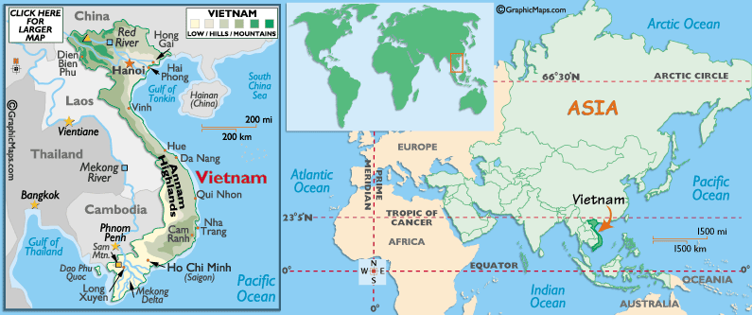

Slide 6
Overview of the Vietnam War

Slide 7
Overview of the Vietnam War
Vietnam: A Painful War
U.S involvement in the conflicts in Vietnam lasted from the mid 1940’s to 1975.
It was the longest war in U.S. history and the only war America lost
Although most Americans were proud to participate in the war the Vietnam War became a study of limits for Americans
The limit of their country’s
Power
Government
And of their country’s “exceptionalism”
This painful awakening remained long in America’s memory, and it shaped U.S. Foreign policy for decades to come

Slide 8
Overview of the Vietnam War
U.S Participation in the War
The U.S. entered the war to prevent communism from spreading to Southeast Asia, and from the rest of the world.
Over the course of the war the U.S. supported the government of South Vietnam against the Communist government of North Vietnam
The U.S. pulled out troops in 1973 and the Communists took over Vietnam in 1975
Notes:
http://www.teacherspayteachers.com/Store/Chalk-Dust-Diva Copyright © 2012 Chalk-Dust-Diva

Slide 9
Overview of the Vietnam War
The Costs of the War
Over 57,000 Americans and 4 million Vietnamese were killed in the Vietnam War.
In 1982 the U.S. government unveiled the Vietnam War Memorial located in Washington D.C.
“the war in Vietnam was a war that nobody won -a struggle between victims. Its origins were complex, its lesson disputed, its legacy still to be assessed by future generations. But whether a valid venture or a misguided endeavor, it was a tragedy of epic dimensions” Stanley Karnow

Slide 10
A. The French in Vietnam
Pair-Share:
What countries are part of French Indochina?
What value would Indochina bring to France?

Slide 11
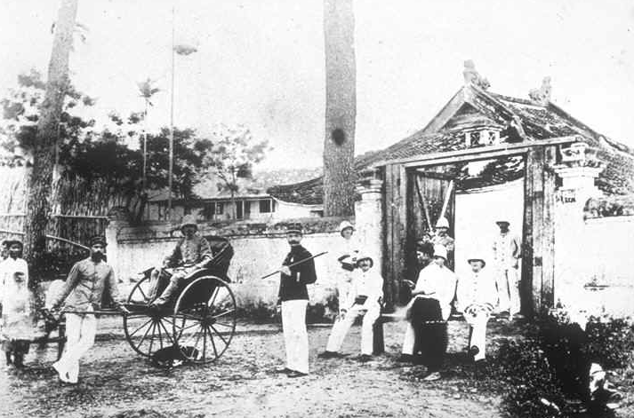
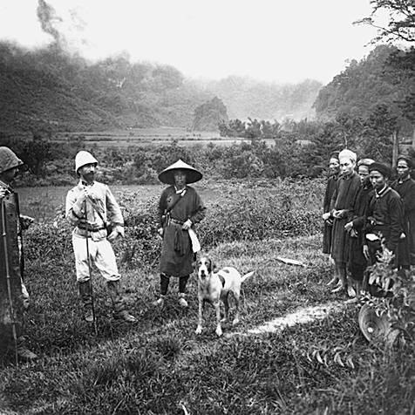
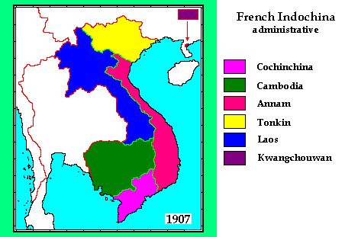
During the Age of Imperialism, the French moved into Southeast Asia and built a colonial empire.

Slide 12
I. The Vietnam War
The French in Vietnam
France occupied Vietnam since 1886

Slide 13
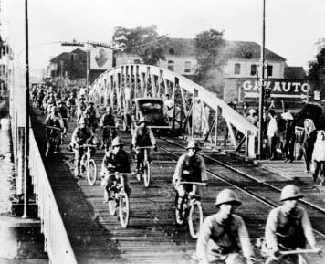
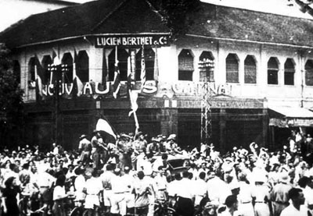
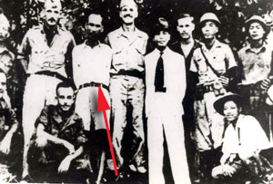
During World War II the Japanese drove the French out of Vietnam.
Vietnamese freedom fighters fought against the Japanese.
Ho Chi Minh meeting with the USA’s OSS.
When Japan was defeated, the French returned…

Slide 14
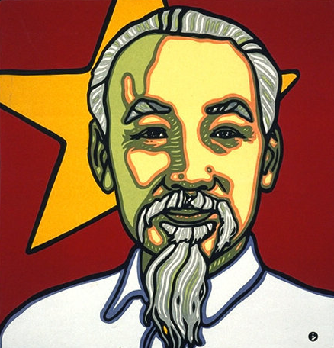
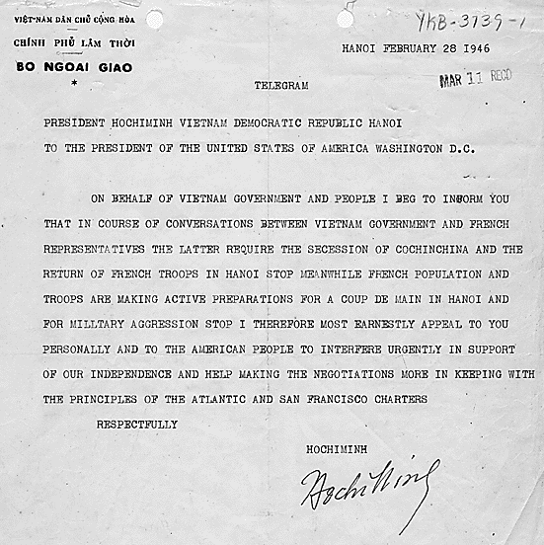
Ho Chi Minh
nationalist who asked Woodrow Wilson to allow Vietnamese people “self-determination” (after WWI)
after fighting against Japanese, Ho asks the USA to support Vietnamese people’s independence

Slide 15
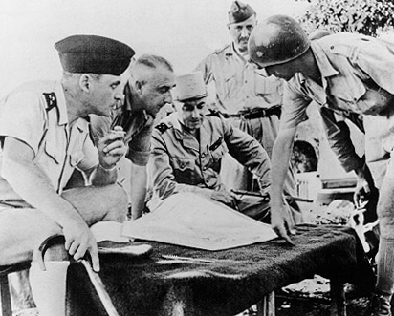
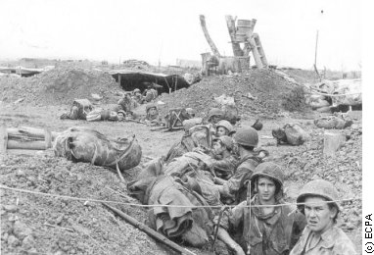
The French could not afford to hold Vietnam.
The USA “helped” France, and by 1954, the USA was paying 80% of the French costs in Vietnam.
After World War II ended, the colonial powers moved back to take over their colonies.
The USA backed the colonial powers.
In 1954, the French lost the Battle of Dien Bien Phu and Vietnam won its freedom.

Slide 16
I. The Vietnam War
The French in Vietnam
France occupied Vietnam since 1886
1941 Ho Chi Minh established the Vietnam Independence League (Viet Minh)
1954 Ho Chi Minh freed Vietnam from France
Vietnam divided:
a. North = Ho Chi Minh (Communist)
b. South = Ngo Dinh Diem

Slide 17
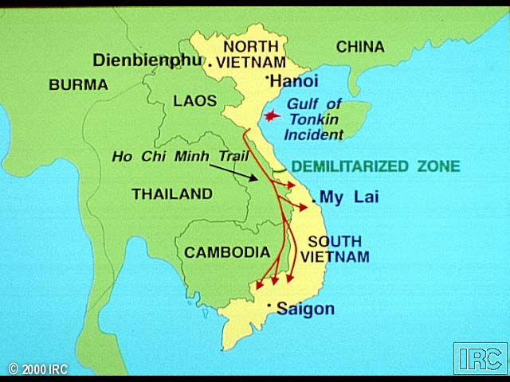

Slide 18
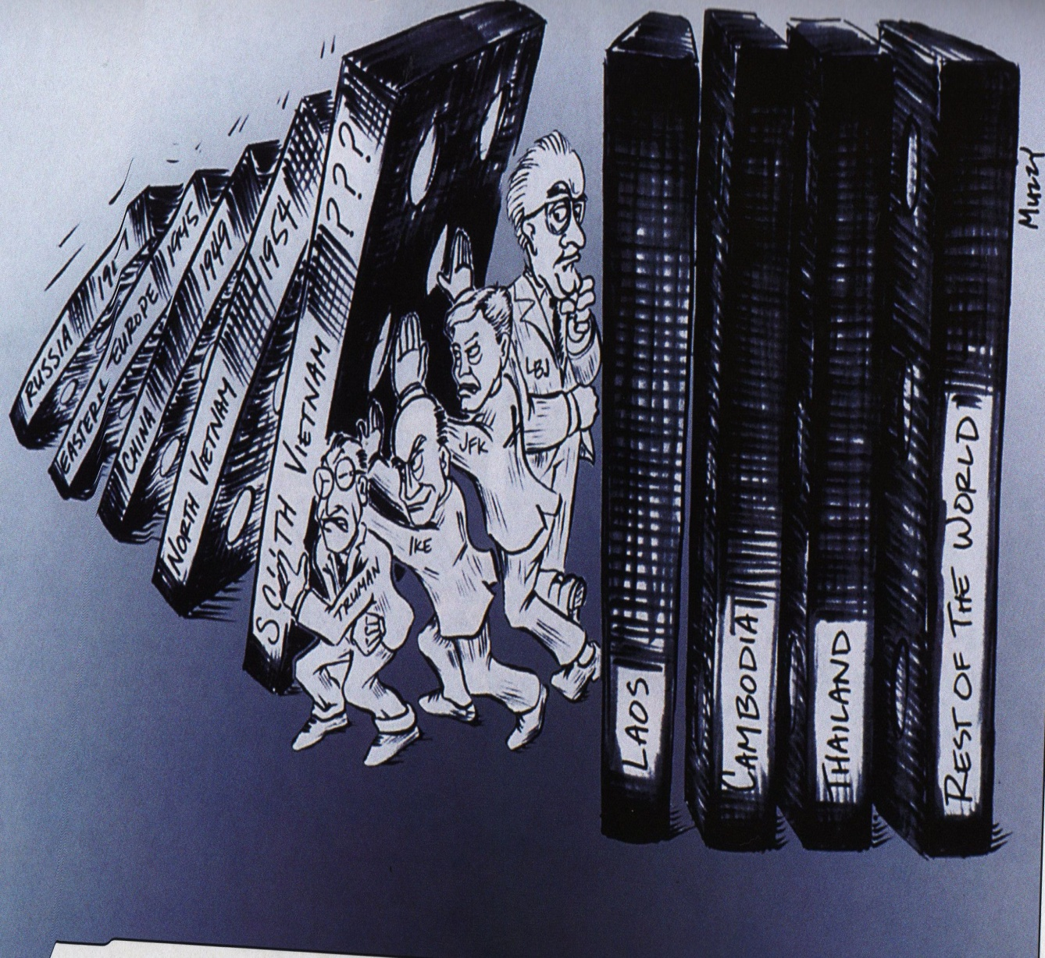
B. Intervention in Vietnam Begins
Pair-Share:
What is happening in this cartoon?
Who is trying to hold up the domino’s?
What theory does this cartoon refer to?
Notes:
http://www.teacherspayteachers.com/Store/Chalk-Dust-Diva Copyright © 2012 Chalk-Dust-Diva

Slide 19
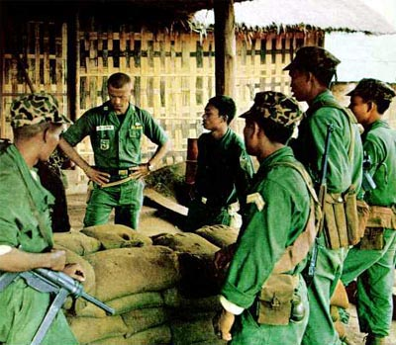
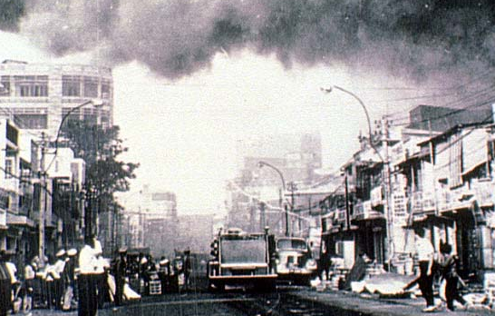
The USA is worried about the “Domino Theory”
The USA sends supplies and money to South Vietnam.
It also provides special forces training and military advisors.
South Vietnam becomes unstable.
Vietcong forces fight to get a communist government in the South.

Slide 20
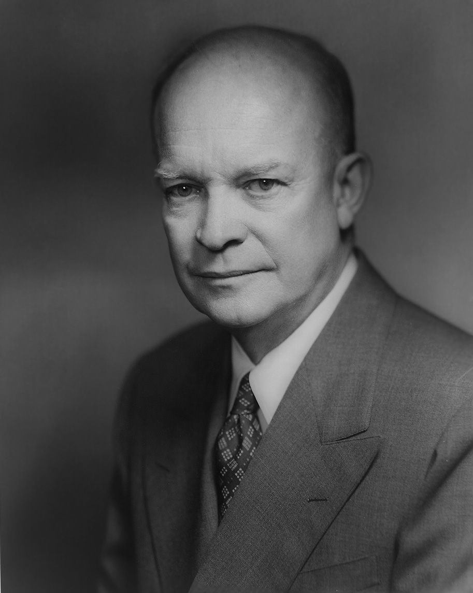
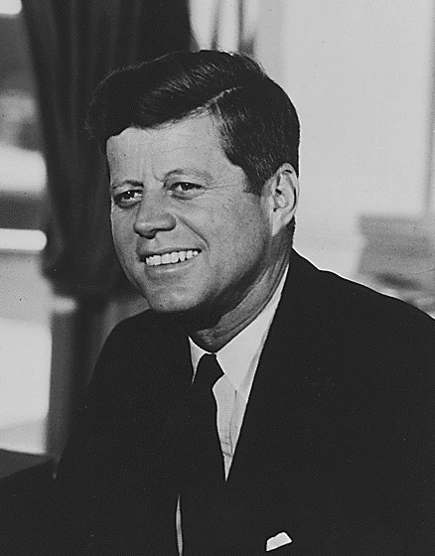
I. The Vietnam War
B. U.S. Intervention in Vietnam Begins
Eisenhower’s “Domino Theory”
a. If Vietnam falls to Communism so will the rest of Indochina
b. Kennedy supports Diem

Slide 21
C. U.S. Presence Escalates in Vietnam

Slide 22
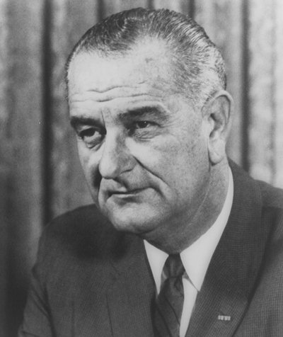
Vice President Lyndon B. Johnson becomes President after JFK is assassinated on November 22, 1963.
Johnson was pressured to send more troops to Vietnam
Johnson had misgivings about American involvement in Vietnam. He said…
“Vietnam was the biggest damn mess I ever saw”…
“I don’t think it’s worth fighting for and I don’t think we can get out.”
Despite his doubts, he felt great pressure to deepen U.S. involvement in Vietnam.
He was afraid that if he appeared “soft” on communism he would not be reelected President in 1964.

Slide 23
C. U.S. Presence Escalates in Vietnam
Lyndon B. Johnson sent more troops to Vietnam

Slide 24
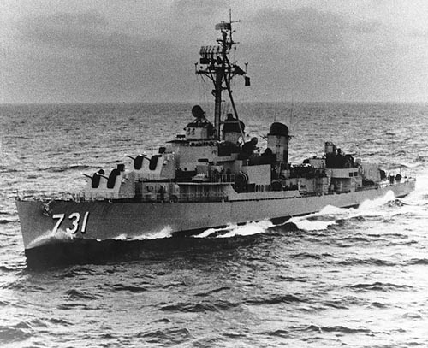
On July 30, 1964, the U.S. destroyer Maddox steamed into the coastal waters of North Vietnam known as the Gulf of Tonkin.

Slide 26
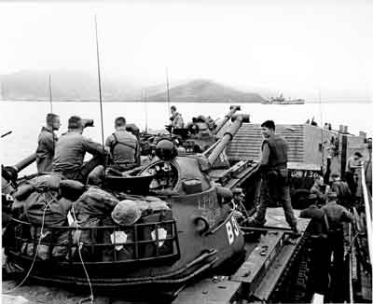
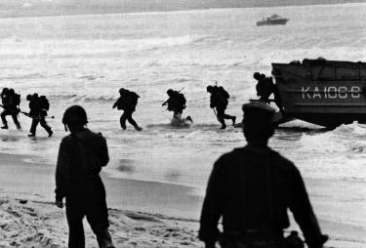
After the attack on the USS Maddox, President Johnson requests Congress give him the power to send more troops to Vietnam in the “Gulf of Tonkin Resolution”

Slide 27
The Gulf of Tonkin Resolution
Read and answer the following Questions:
Where were the U.S. naval vessels when they were attacked by the North Vietnamese?
Summarize (in your own words) the foreign policy of the U.S. in Asia since 1954?
What has the North Vietnamese sought to do in Vietnam? What agreement did they violate?
In your own words, what did the Gulf of Tonkin Resolution do in regards to Vietnam?

Slide 28
The Gulf of Tonkin Resolution
The resolution gave the president the right to “take all necessary measures” to defend any nation in Southeast Asia threatened by Communist “aggression or subversion”

Slide 29
C. U.S. Presence Escalates in Vietnam
Lyndon B. Johnson sent more troops to Vietnam
The Gulf of Tonkin Resolution
a. Gave Johnson legal right to send more troops to Vietnam without an official U.S. declaration of war.

Slide 30
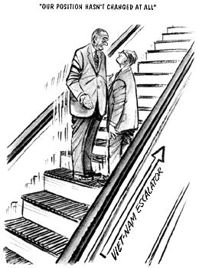
In 1965 President Johnson announced that the USA was not changing its policy in Vietnam.
And yet, at the same time, the Department of Defense announced that the USA was sending an additional 21,000 troops to Vietnam.
The artist shows the president going up an escalator. He claims that he is not changing the USA’s position, but the escalator continues to climb, just as the USA’s involvement in Vietnam.
Notes:
http://www.teacherspayteachers.com/Store/Chalk-Dust-Diva Copyright © 2012 Chalk-Dust-Diva

Slide 31
D. Hardship and Disillusionment on the War Fronts

Slide 32
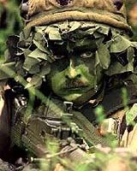
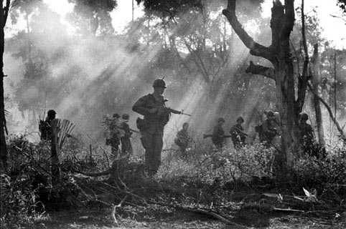
Guerilla Warfare
The fighting in Vietnam was unlike virtually anything U.S. troops had previously experienced.
Vietnam:
Wet
Dense jungle terrain
Humid
hot
North Vietnamese & Viet Cong troops used various guerilla tactics to attack U.S. forces.
“cling to the enemy’s belt”
Ambush U.S. Patrols
Land mines
Booby traps

Slide 33
D. Hardship and Disillusionment on the War Fronts
Guerilla Warfare
a. sudden unexpected attacks carried out by an unofficial military group or groups that are trying to change the government by assaults on the armed forces
Advantages for Vietnamese
a. Knowledge of terrain
b. Hit-and-run tactics
c. Well disciplined
Disadvantages for U.S. Troops
a. Difficult for U.S. troops to distinguish between friends & enemies
b. Growing U.S. disillusionment

Slide 34
Song: “Six Clicks” (Herschel Gober)
Six clicks is a mighty short walk
When you march behind a band
Six clicks can seem like a hundred miles
When you’re walking in Charlie’s land

Slide 35
With a pack upon your back, a rifle in your hand
Every step you take, death is holding your hand
Walking in Charlie’s land

Slide 36
Up before the crack ‘o dawn, out in the brush
Every clump of trees can hide an ambush.
You must not relax, don’t lay your rifle down.
Remember, buddy, you’re trespassing on Charlie’s ground.
This is Charlie’s ground

Slide 37
There’s mud, mosquitoes, and snakes,
Mines and pungii stakes.
Some of our boys found out to late just who owns this real estate.
This is Charlie’s land.

Slide 38
Six clicks is a mighty short walk
When you march behind a band.
Six clicks can seem like a hundred miles
When you’re walking in Charlie’s land.
Walking in Charlie’s land.

Slide 39
Song Analysis
What does the word “Charlie” refer to?
Answer: Slang for Viet Cong (VC). The term is short for the phonetic spelling (used by the military and police to spell things over the radio) of "VC," which is "Victor Charlie."
“Some of our boys found out to late just who owns this real estate.” –What is the meaning of this quote?
What is the tone of the song?

Slide 40
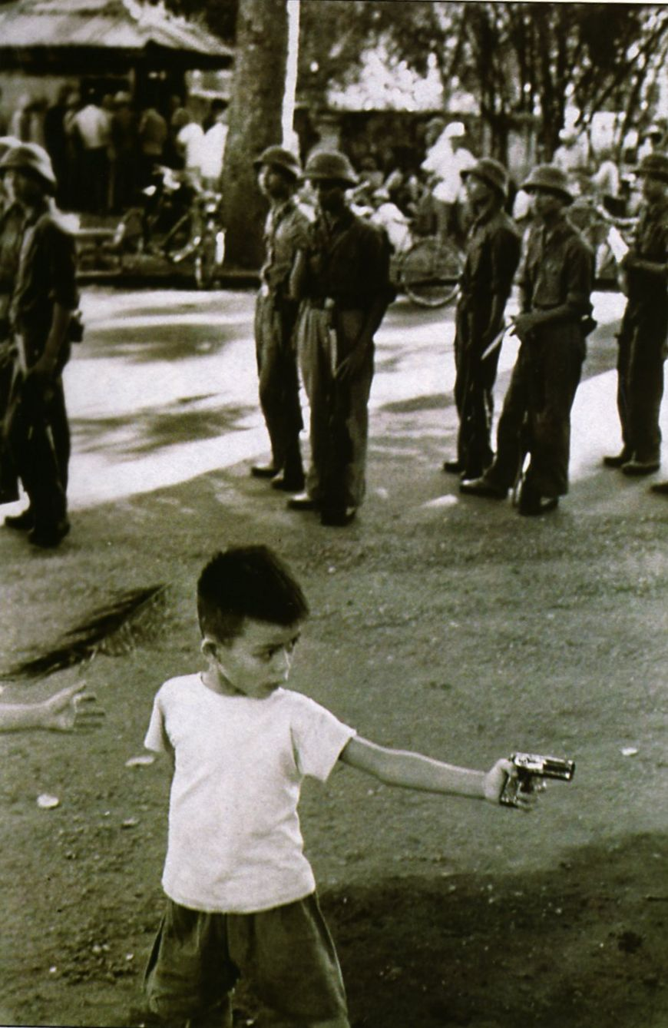
E. Vietnamese Nationalism and Determination

Slide 41
E. Vietnamese Nationalism & Determination
The Vietnamese “People’s War”
a. Vietnamese Communists received widespread support
Communist Sacrifices
a. ½ million troops died in action
The Ho Chi Minh Trail
a. Communists used trail that ran from North to South Vietnam via Cambodia & Laos to transport equipment and troops.
The Plight of Vietnamese Civilians
a. North - 80% killed were civilians
b. South – U.S. destroyed villages
c. Napalm bombs used – burned whatever it touched.

Slide 42
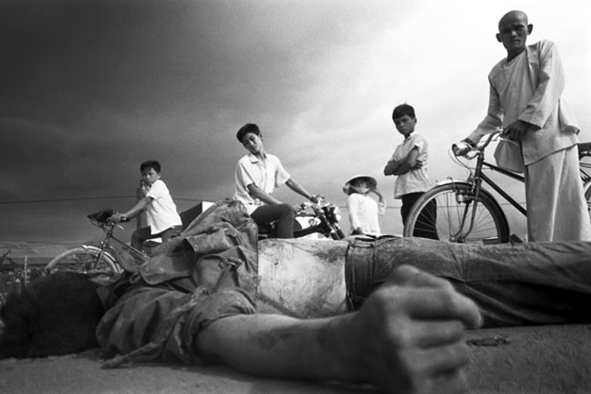
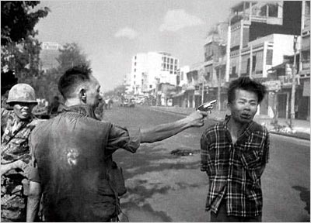
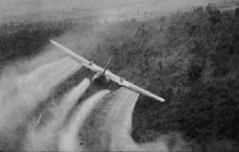
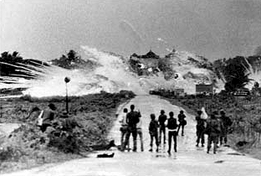
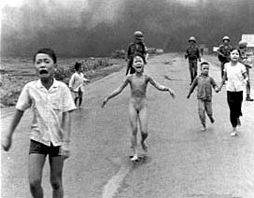
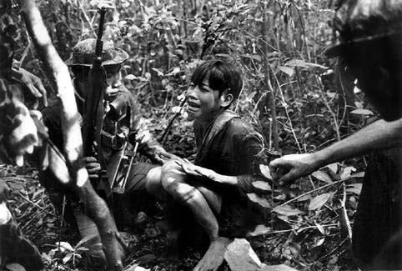
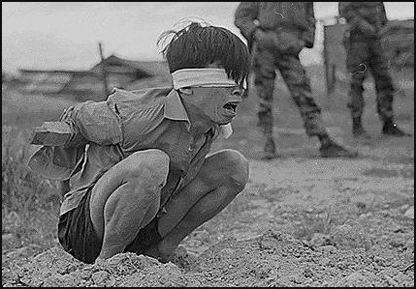
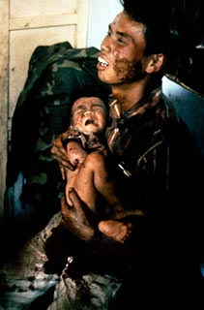
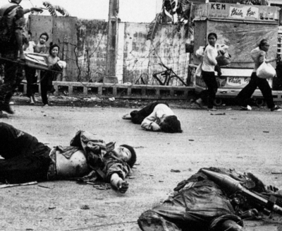
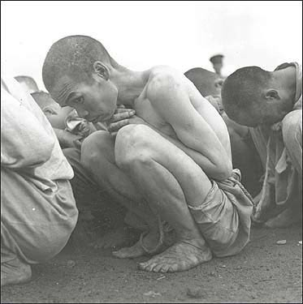
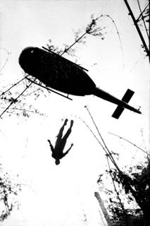
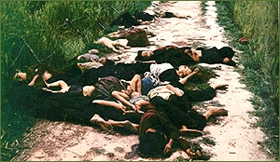
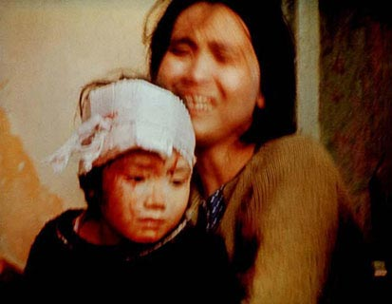
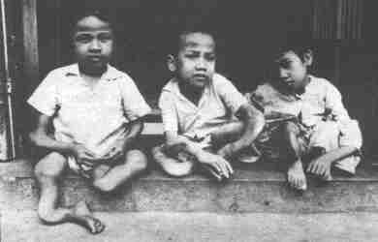
Total War in Vietnam

Slide 43
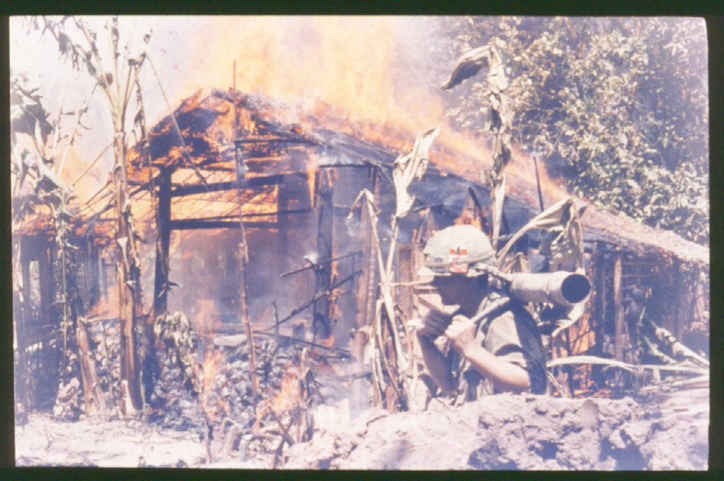
F. American Public Support For the War Wanes

Slide 44
F. American Public Support for the War Wanes
Antiwar Demonstrations at Home
When U.S. bombings of Vietnam began in 1965 so did protest demonstrations
1st major antiwar protest = 4/17/65 – Washington D.C. – 20, 000 participants
1969- ½ million participants
Unpopularity of the War
Reasons for:
1. LBJ sending more troops = more casualties
2. American uncertainty of fighting war
3. Horrifying images of war

Slide 45
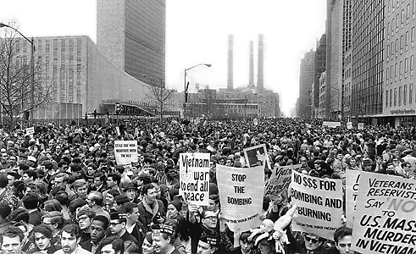
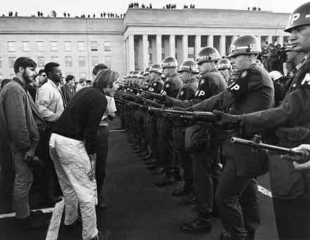
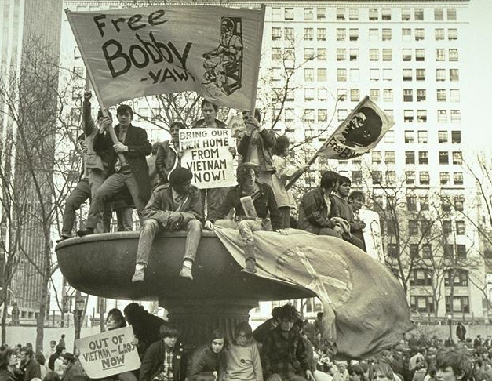
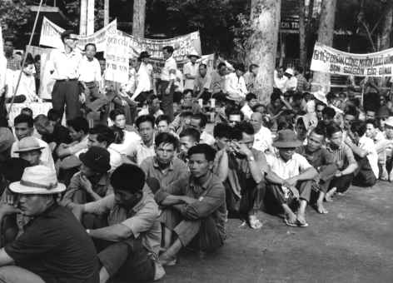
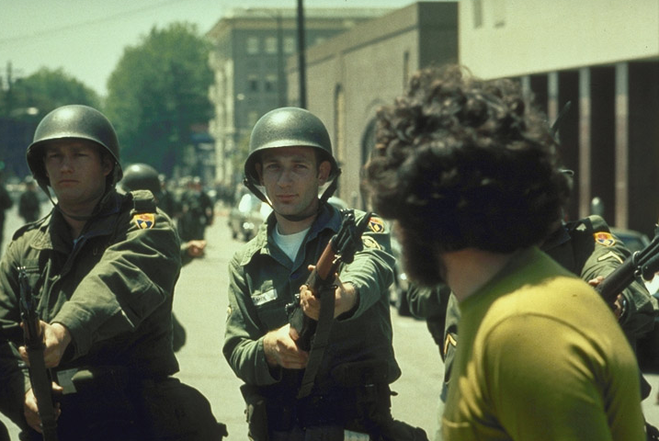
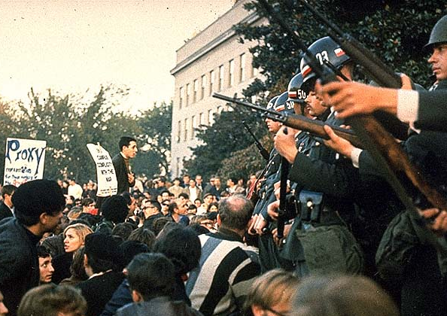
Protests against the war
in Vietnam
and in the USA

Slide 46
F. American Public Support for the War Wanes
iii. Resistance to the Draft
a. burned draft cards
b. Refused to register
c. Registered as conscientious objectors
d. 15 million applied for draft deferments
e. ½ million hid or fled
iv. U.S. Leaders Speak Out
a. Famous leaders (ie. Martin Luther King) publicly condemned the war.

Slide 47
G. Fighting a Losing Battle

Slide 48
G. Fighting a Losing Battle
The War Reaches Its Height
1968-1969
1. 500,000 U.S. troops in Vietnam
2. U.S. dropped 1.2 million tons of bombs
3. 400,000 air strikes
4. Destroyed 20,000 acres of vegetation
5. ½ million refugees
6. 130,000 civilians killed per month

Slide 49
G. Fighting a Losing Battle
The War Reaches Its Height
1968-1969
1. 500,000 U.S. troops in Vietnam
2. U.S. dropped 1.2 million tons of bombs
3. 400,000 air strikes
4. Destroyed 20,000 acres of vegetation
5. ½ million refugees
6. 130,000 civilians killed per month
The Tet Offensive
a. Jan. 31, 1968 – 70,000 communists surprise attack on South Vietnam
b. Attacked U.S. embassy
c. Defeat for Vietcong
d. Turned Americans against U.S. involvement in war

Slide 50
G. Fighting a Losing Battle
iii. The Cost of the War
1967 – cut $6 billion from domestic budget
10% tax on U.S. goods
iv. Johnson Leaves Office
March 31, 1968 LBJ announced
1. U.S. would decrease bombings & was open to negotiation
2. He would not run for reelection

Slide 51
H. Violence Escalates at Home and Abroad

Slide 52
H. . Violence Escalates at Home & Abroad
i. The 1968 Presidential Election
Hubert Humphrey (D) vs. Richard Nixon (R)
1. Nixon wins
ii. The My Lai Massacre
a. U.S. troops killed 200 innocent civilians
iii. Nixon’s Policy of “Peace with Honor”
a. “Vietnamization”
Pulling U.S. troops out of Vietnam and transferring the war to the S. Vietnamese
Henry Kissinger (national security advisor) – peace talks with North Vietnamese gov’t.
vi. U.S. Bombings in Cambodia
1969 Nixon bombs neutral Cambodia
Escalating Protests and Kent State Shootings
U.S. protests bombing of Cambodia
Students hold protests around U.S.
1970 police kill 4 students at Kent state

Slide 53
Film Clip:
Letters Home From Vietnam
Notes:
10 minute film clip

Slide 54
I. The United States Pulls Out of the Vietnam War

Slide 55
I. The U.S. Pulls Out and the Vietnam War Ends
Peace Talks Falter
War spreads to Laos
Ho Chi Minh dies -1969
Public nor private talks were successful
ii. Cease-Fire Declared
a. Jan. 27, 1973
b. Paris Agreement:
1. N – keep 150,000 troops in South Vietnam
2. S. Vietnamese leader: Thieu stayed in power
iii. U.S. Forces Leave Vietnam
a. March 27th, 1973 last U.S. troops leave Vietnam
b. August 1973 Nixon stops bombing Cambodia – U.S. War in Vietnam ends
iv. Fighting Resumes in Vietnam
a. U.S. sends billions in aid
b. 1975 The Fall of Saigon
c. April 30th, 1975 South Vietnam surrenders
Notes:
http://www.teacherspayteachers.com/Store/Chalk-Dust-Diva Copyright © 2012 Chalk-Dust-Diva

Slide 56
In 1975, the Communist Vietcong overran Saigon.
Thousands of people fled to the American Embassy to be evacuated.

Slide 57
I. The U.S. Pulls Out and the Vietnam War Ends
The Effects of the Vietnam War
U.S.
58,000 killed
303,000 wounded
750 POW’s
4. $120 billion
5. Vets suffer – depression, drugs addiction, cancer
b. Vietnam
1. 4 million killed (soldiers & civilians)
2. displaced thousands of Vietnamese – 1 million fled Vietnam

Slide 58
I. The U.S. Pulls Out and the Vietnam War Ends
The Effects of the Vietnam War
U.S.
58,000 killed
303,000 wounded
750 POW’s
4. $120 billion
5. Vets suffer – depression, drugs addiction, cancer
b. Vietnam
1. 4 million killed (soldiers & civilians)
2. displaced thousands of Vietnamese – 1 million fled Vietnam
c. Vietnam After the War
1. Pham Van Dong - Prime Minister
2. struggled to recover after war
3. 1993 U.S. lifted trade embargoes & reestablished diplomatic relations

Slide 59
The War in Vietnam
Song: Imagine – John Lennon

Slide 60
Wrap-Up
Pretend your are an American soldier fighting in the Vietnam War. Write a letter home describing, in detail, your experience in the war.

